Slide 1
Large Scale RPA
Intelligent Apps

Slide 2
Use Case
Process forms like Expense, PO, Order form, Receipt, Mortgage
First ability to pick the pages to process
  This will reduce unnecessary pages to processed in Cognitive AI
  Will reduce AI cost
Process the necessary pages and store the result as JSON for further processing
Ability to run continuously either push or trigger based daily, weekly. Monthly
Scalable cost-effective solution
HA and DR capable
Cloud Scale to scale as needed

Slide 3
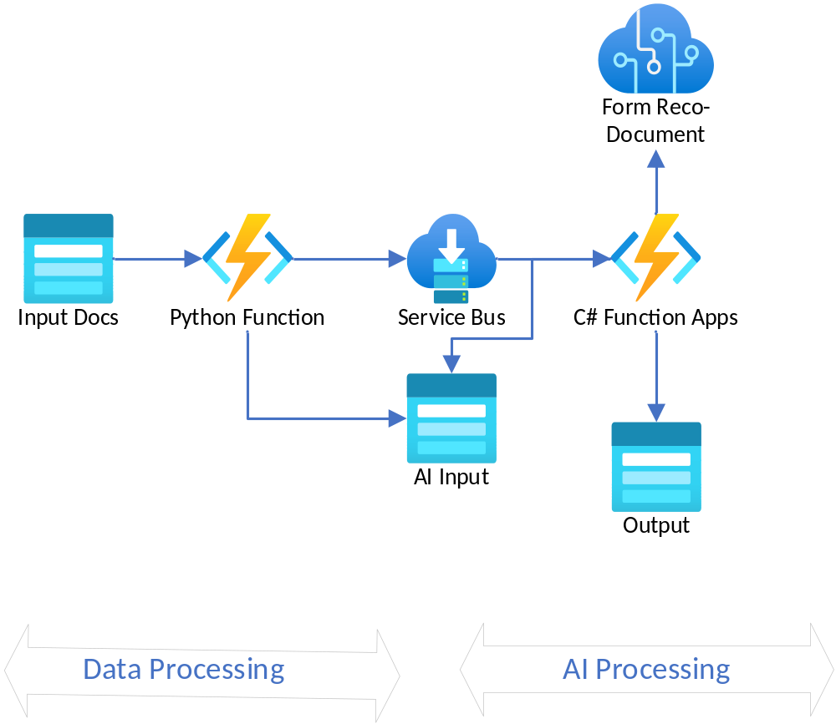
Architecture

